Slide 1




Credit Card Fraud Detection
START!

Slide 2


Contents
Section 1
Section 2
Section 3
Section4
CREDITS
Problem understanding
Data Gathering and Preprocessing
Algorithm Selection and Training
Hyperparameters Tuning and Cross-Validation
Notes:
報告架構

Slide 3


Contents
Stage 1
01.
Stage 2
Stage 3
Stage 4
Credits
Stage 1
START!
Problem understanding

Slide 4


Table of Contents
Credit card fraud and scams become severe.
NTD 570,539,629 in 2014
NTD 3,298,163,266 in 2023
growth
業務統計 | 財團法人聯合信用卡處理中心全球資訊網 (nccc.com.tw)

Slide 5
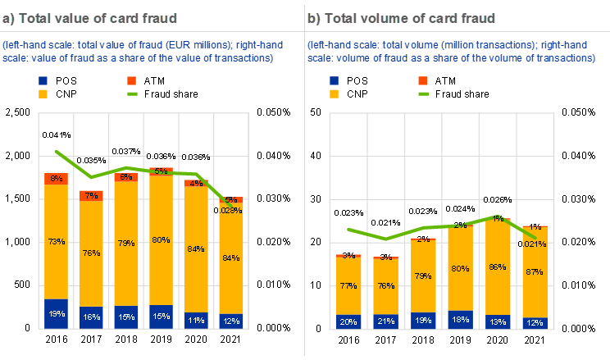
Table of Contents
the vast majority of card fraud related to CNP transactions
CNP means card-not-present
Report on card fraud in 2020 and 2021 (europa.eu)
Notes:
歐盟區2021年詐騙下降原因：due to the widespread adoption of the 3D Secure standard to support strong customer authentication

Slide 6

objectives
Contents
Stage 1
identify credit card transaction anomalies in advance through data features to prevent and timely stop such improper transactions
Stage 2
Stage 3
Stage 4
Credits

Slide 7
Domain Knowledge
Contents
Stage 1
Fraud Patterns and Behaviors
Risk Features
Handling Imbalanced Data
Advanced AI methods from GenAI provide deeper insights
Stage 2
Stage 3
Stage 4
Credits

Slide 8
Formulate Hypotheses
Contents
Stage 1
Does the likelihood of credit card fraud increase with higher transaction amounts?
If there are tests before credit card fraud, are there any traceable patterns in the transaction amounts?
Which features are highly correlated with credit card fraud?
Stage 2
Stage 3
Stage 4
Credits

Slide 9

Develop Data Collection Strategy
choose
read
decide
Contents
Stage 1
Stage 2
Stage 3
Stage 4
Utilizing Kaggle data
Sep 2013 in Europe
Occurred in two days
492 frauds out of 284,807
Highly unbalanced
Time
Amount
Class
28 PCA-processed data
Credits
(Ref: https://www.kaggle.com/datasets/mlgulb/creditcardfraud?resource=download)

Slide 10

Stage 1
02.
Section 2
Stage 3
Stage 4
Section 2
Credits
START!
Contents
Stage 2
Stage 2
Data Gathering and Preprocessing

Slide 11
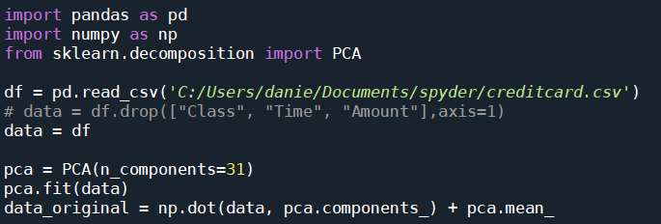
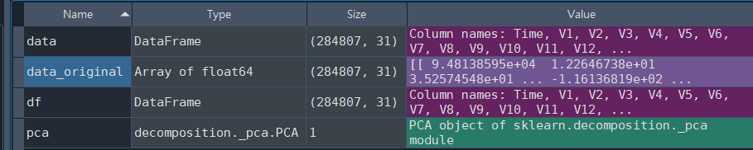
PCA transform : trial on data
Contents
Stage 1
Section 2
Stage 2
Stage 3
Stage 4
Credits
When we applied it to our data, tried to reverse-transform and analyze the data, we found the analysis had no impact after completion.

Slide 12



real world defined by AI
Contents
Stage 1
merch_long
gender
Section 2
Stage 2
cc_num
state
is_fraud
Stage 3
long
dob
merchant
lat
first
Stage 4
unix_time
category
last
trans_num
Credits
unix_time
amt
street
job
merch_lat
city
city_pop
zip
city_pop

Slide 13
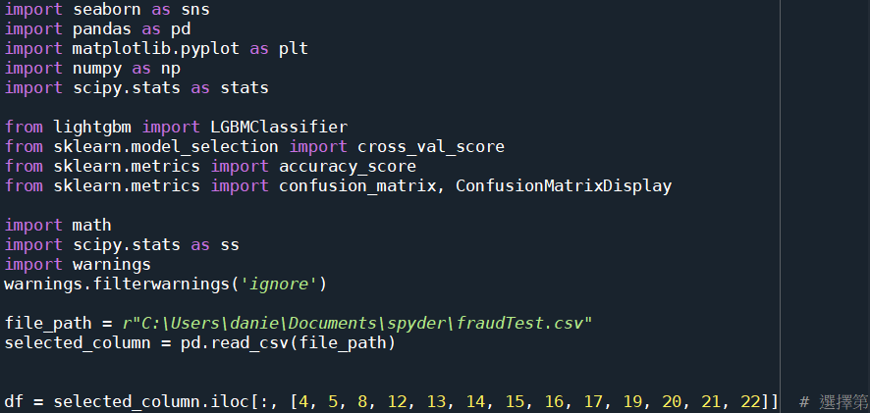
How to sort a string in python
Contents
Stage 1
Section 2
Stage 2
Stage 3
Stage 4
Credits
(Ref: https://www.kaggle.com/datasets/kartik2112/fraud-detection/data)

Slide 14
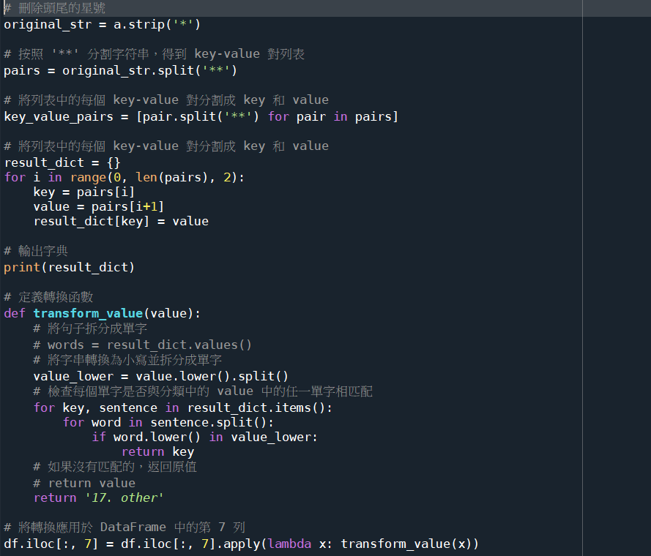
Contents
Stage 1
Section 2
Stage 2
Stage 3
Stage 4
Credits

Slide 15
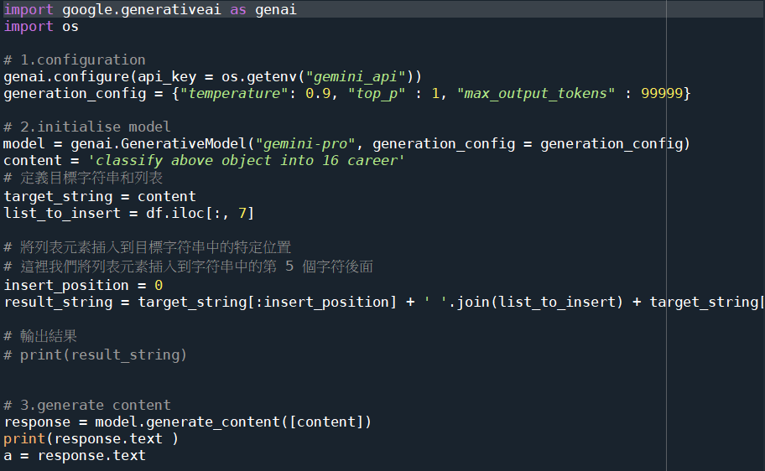
The AI sorting result
Contents
Stage 1
Section 2
Stage 2
Stage 3
Stage 4
Credits

Slide 16
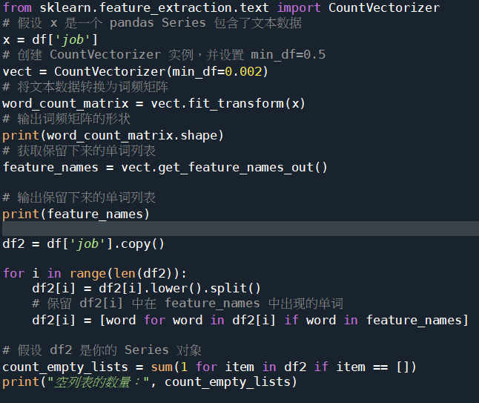
Contents
Stage 1
Section 2
Stage 2
Stage 3
Stage 4
Credits
Notes:
利用字串頻率分類的方法

Slide 17
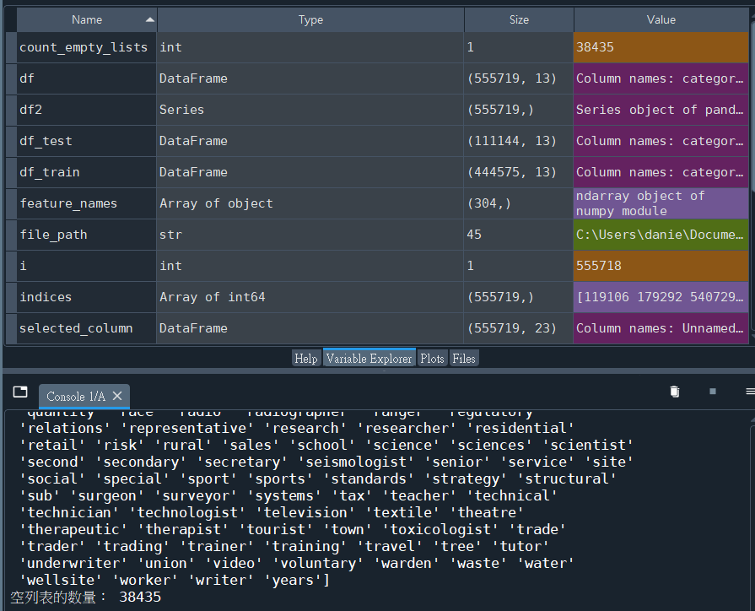
Contents
Stage 1
Section 2
Stage 2
Stage 3
Stage 4
Credits
Notes:
利用字串頻率分類的方法

Slide 18

Ensure Data Diversity and Prevent Bias and Ethical Issues
In two days
284,807 transactions in Europe
diversity
bias
ethical issues may not be entirely avoided
temporal and regional limitations
Contents
Stage 1
Section 2
Stage 2
Stage 3
Stage 4
Credits

Slide 19

03.
Section 3
START!
Contents
Stage 1
Section 2
Stage 2
Stage 3
Stage 4
Credits
Algorithm Selection and Training

Slide 20
Define evaluation metrics
F1
ROC_AUC
accuracy
recall
MSE
Contents
Stage 1
Section 2
Stage 2
Stage 3
Stage 4
Credits
R-squared

Slide 21
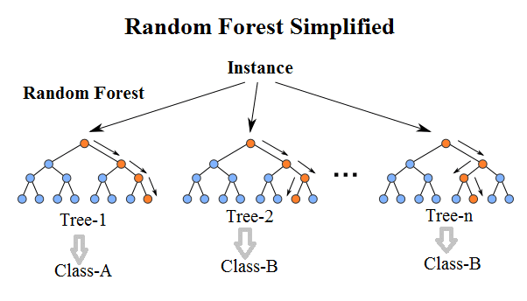
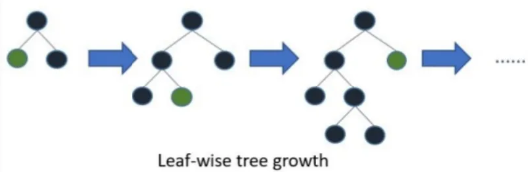
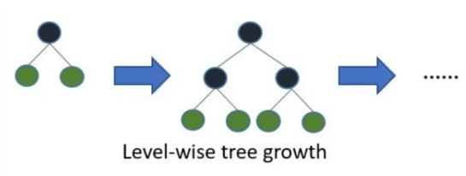
Select appropriate models
RF
LGBM
XGB
Contents
Stage 1
Section 2
Stage 2
Stage 3
Stage 4
Credits

Slide 22
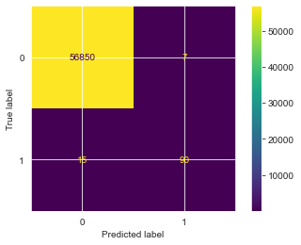
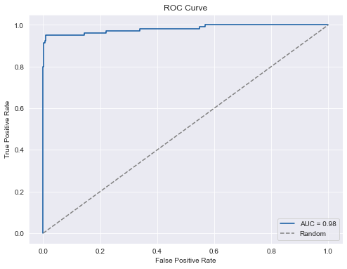
Define evaluation metrics
Contents
cross-validation : 4 folds
f1 : 0.8645197101436476
roc_auc : 0.9837418908093732
test set
accuracy : 0.9996137776061234
recall : 0.8571428571428571
f1-score : 0.8910891089108911
roc_auc : 0.9823172085021988
Stage 1
Section 2
Stage 2
Stage 3
Stage 4
Credits
lightGBM

Slide 23

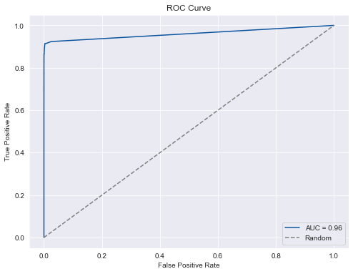
Define evaluation metrics
Contents
cross-validation : 4 folds
f1 : 0.84652082553703
roc_auc : 0.9413412240658633
test set
accuracy：0.9995786664794073 precision：0.9354838709677419
recall：0.8285714285714286
f1：0.8787878787878788
ruc_aoc ： 0.9606880084288318
Stage 1
Section 2
Stage 2
Stage 3
Stage 4
Credits
Random Forest classifier

Slide 24

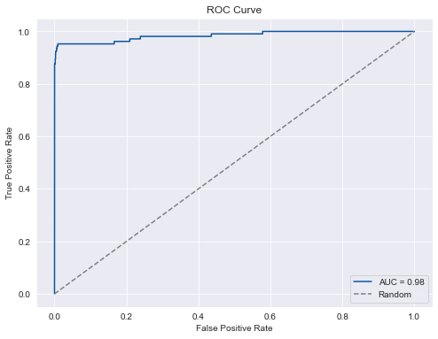
Define evaluation metrics
Contents
cross-validation : 4 folds
f1 : 0.8597295044801769
roc_auc : 0.9818700142894985
test set
accuracy：0.9996313331694814
precision：0.9565217391304348
recall ：0.8380952380952381
f1：0.8934010152284264
roc_auc：0.9841691394534491
Stage 1
Section 2
Stage 2
Stage 3
Stage 4
Credits
XGBoost

Slide 25

START!
04.
Section 4
Contents
Stage 1
Section 2
Stage 2
Stage 3
Stage 4
Credits
Hyperparameters Tuning and Cross-Validation

Slide 26
Analyze Feature Importance
Contents
Tree-based Models:
Random Forests and Gradient Boosting Machines (GBM) have built-in mechanisms to evaluate feature importance. After training these models, you can extract the feature importance scores. Below is an example of how to perform importance analysis using LightGBM:
Steps:
Train the model using your dataset, including PCA features, time, amount, and fraud labels.
Extract feature importance scores using the model’s feature importance attribute (e.g., model.feature_importances_ in scikit-learn).
Plot the feature importance scores to visually identify the most influential features.
Stage 1
Section 2
Stage 2
Stage 3
Stage 4
Credits

Slide 27
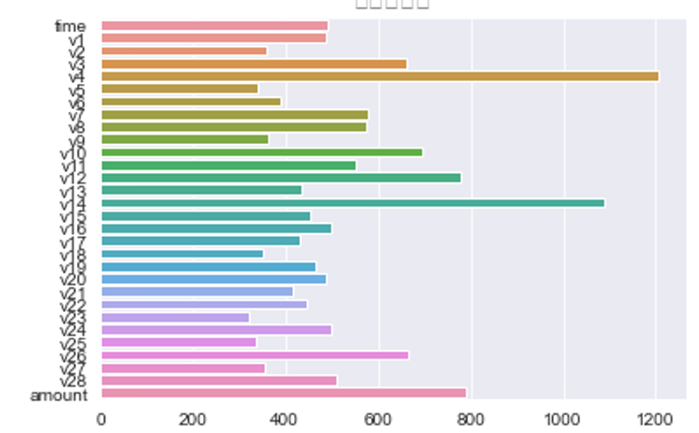
Analyze Feature Importance
Contents
import matplotlib.pyplot as plt
import seaborn as sns
from sklearn.ensemble import RandomForestClassifier
model = lgbm_opt
model.fit(X_train, y_train)
# 提取特徵重要性
importances = model.feature_importances_
feature_names = X_train.columns
# 繪圖
sns.barplot(x=importances, y=feature_names)
plt.show()
Stage 1
Section 2
Stage 2
Stage 3
Stage 4
Credits

Slide 28
SHAP
Contents
SHAP values provide a unified measure of feature importance that is consistent and interpretable for any machine learning model.
Steps:
Install SHAP: Ensure you have the SHAP library installed. pip install shap
Train Your Model: Train your model (e.g., XGBoost, LightGBM, or any other model).
Calculate SHAP Values: Initialize the SHAP explainer for your model. Calculate SHAP values for your dataset.
Visualize SHAP Values: Use SHAP plots to visualize the impact of each feature on the model’s predictions.
Stage 1
Section 2
Stage 2
Stage 3
Stage 4
Credits

Slide 29
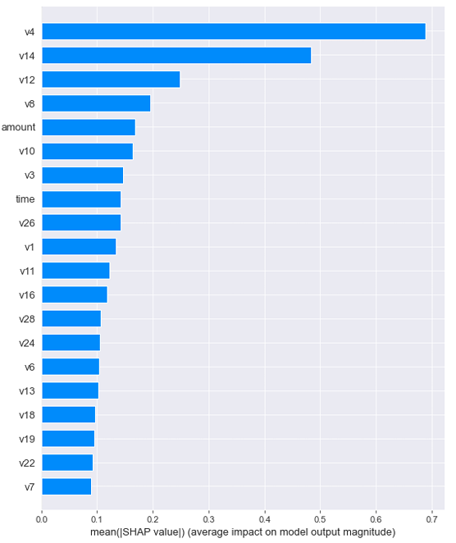
SHAP
import shap
# 初始化SHAP解釋器
explainer = shap.TreeExplainer(model)
# 計算SHAP值
shap_values = explainer.shap_values(X_train)
# 摘要圖
shap.summary_plot(shap_values, X_train, plot_type="bar")
Contents
Stage 1
Section 2
Stage 2
Stage 3
Stage 4
Credits

Slide 30
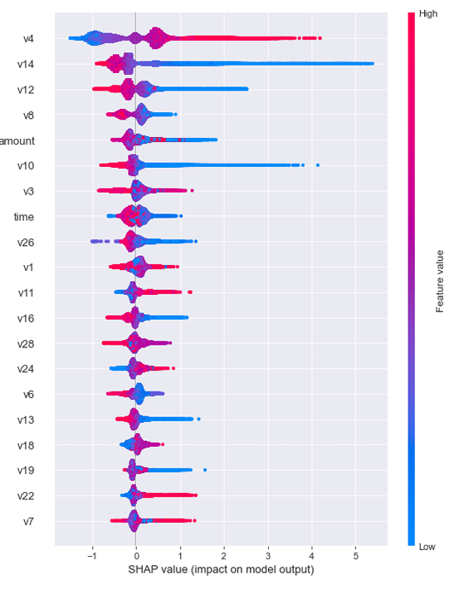
SHAP
Contents
# 詳細的特徵影響 shap.summary_plot(shap_values, X_train)
Stage 1
Section 2
Stage 2
Stage 3
Stage 4
Credits

Slide 31
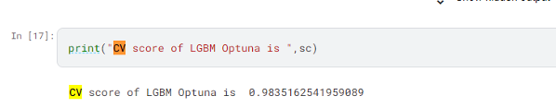
Cross-Validation
Contents
sc=cross_val_score(lgbm_opt,X_train.values,y_train.values,cv=4, scoring = 'roc_auc').mean()
Stage 1
Section 2
Stage 2
Stage 3
Stage 4
Credits

Slide 32
Perform Hyperparameter Tuning
Contents
Optuna package
We are currently employing the Grid Search strategy, rather than Random Search
The suggest_int function with Tree-structured Parzen Estimator (TPE) algorithm
Param set
Optuna.create_study
Stage 1
Section 2
Stage 2
Stage 3
Stage 4
Credits

Slide 33
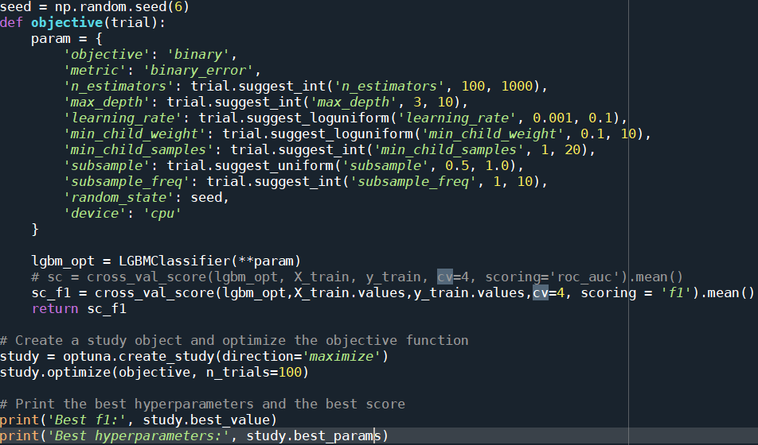
hyperparameter fintune
Contents
Stage 1
Section 2
Stage 2
Stage 3
Stage 4
Credits

Slide 34

lgbm finetune hyperparameter and the result
Contents
[I 2024-06-04 14:30:00,146] Trial 99 finished with value: 0.8551035712090479 and parameters: {'n_estimators': 868, 'max_depth': 10, 'learning_rate': 0.021761814490323127, 'min_child_weight': 1.6257561621727814, 'min_child_samples': 17, 'subsample': 0.7353643394926868, 'subsample_freq': 2}. Best is trial 79 with value: 0.8687600294385209.
Best f1: 0.8687600294385209
Best hyperparameters: {'n_estimators': 949, 'max_depth': 9, 'learning_rate': 0.031359496322390004, 'min_child_weight': 1.6586878455948058, 'min_child_samples': 18, 'subsample': 0.7435222447895633, 'subsample_freq': 2}
Stage 1
Section 2
Stage 2
Stage 3
Stage 4
Credits

Slide 35
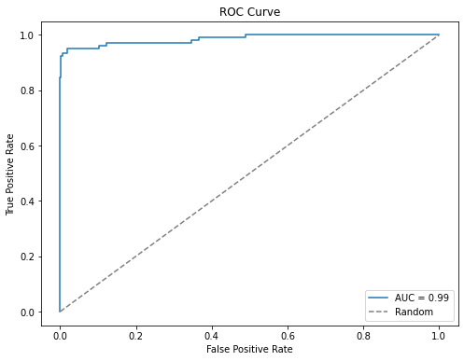
lgbm finetune hyperparameter and the result
Contents
training set：
f1 : 0.8687600294385209
roc_auc : 0.9823152530640205
accuracy ： 0.9997015554229135
recall ： 0.8666666666666667
f1 = 0.914572864321608
roc_auc ： 0.9859441857894116
Stage 1
Section 2
Stage 2
Stage 3
Stage 4
Credits

Slide 36
Regularization
Contents
On Regularization Techniques:
L1(Lasso) and L2(Ridge) regularization not utilized to mitigate overfitting in this project
Reasons:
Dataset size of several hundred thousand records
Have hundred of fraud cases
Modest number of parameters
Overfitting unlikely to be a significant concern
Stage 1
Section 2
Stage 2
Stage 3
Stage 4
Credits
Notes:
是因為有夠多的fraud case才不會overfit

Slide 37
Thanks!
Table of Contents
Section 1
Section 2
Section 3
Section 4
Credits
Reference： AI and Big Data Algorithms in Practice Report Worksheet (google.com) https://www.kaggle.com/code/sinanbavli04/credit-card-fraud-detection-with-nice presentation#notebook-container https://www.kaggle.com/datasets/mlg-ulb/creditcardfraud?resource=download

